Slide 1
SECURELY SHARING DESKTOP APPLICATIONS TO BROWSER
Team members:
1.Gayethiri.R.S
2.Inba.M
3.Mary metilda.S
Industry Mentor
Ms.Gomathi
Faculty Guide:
Mrs.Jayashree
Department of CSE, KGiSL Institute of Technology, Coimbatore

Slide 2
Abstract
Installation and configuration of applications on AppStream and stream the applications to the users. Applications can be accessed through HTML 5 browser. The accessing permissions will be controlled. The administrative tasks can be performed in the AppStream console.Applications can be installed using image builder. The provision to an Amazon Virtual Private Cloud(VPC) using a provided AWS Cloud Formation Template. The VPC service will host the AppStream 2.0 resources within the isolated virtual network infrastructure.

Slide 3
Area Introduction-Existing system
The desktop applications can be shared to the browser. This applications will be saved in the server. The assurance of secure usage of applications cannot be given in this system.
Department of CSE, KGiSL Institute of Technology, Coimbatore

Slide 4
Proposed System
Advantages over existing methods
Scalability-It enables you to accommodate larger workloads without disruption of existing infrastructure.
Future Enhancements
The datas will be more securely shared to browser without any server problems.
The shared applications,datas can be secured in VPC services and will be available.
Department of CSE, KGiSL Institute of Technology, Coimbatore

Slide 5
Literature Review
Drawbacks of existing methods
Server problems
Accessing applications through server
Department of CSE, KGiSL Institute of Technology, Coimbatore

Slide 6
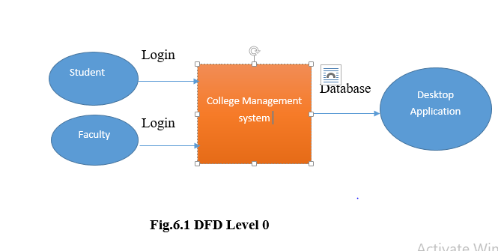
Data Flow Diagram - Level 0

Slide 7
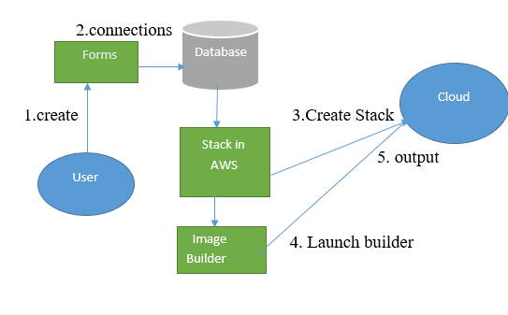
DATA FLOW DIAGRAM-LEVEL 1

Slide 8
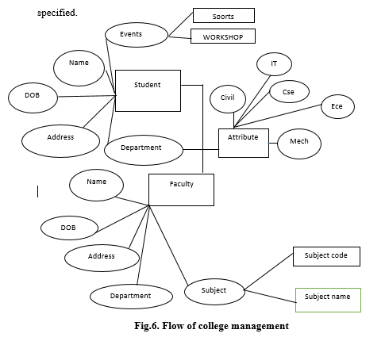
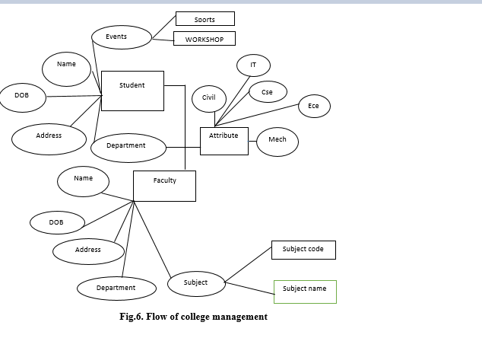
ER DIAGRAM

Slide 9
Module Split-up
Module 1:
Creating Network Resources and appsteam image builder
Module 2:
Connect to the image builder and install the app
Module 3:
create AppStream Image.
Module 4:
Provision a fleet and Appstream Stack and Manage Users.
Module 5:
Testing the User Experience and Streaming.
Department of CSE, KGiSL Institute of Technology, Coimbatore

Slide 10
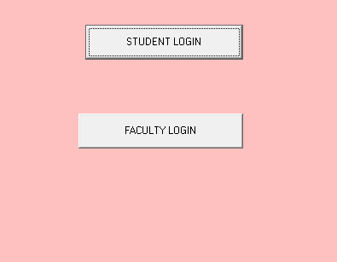
SNAPSHOTS

Slide 11
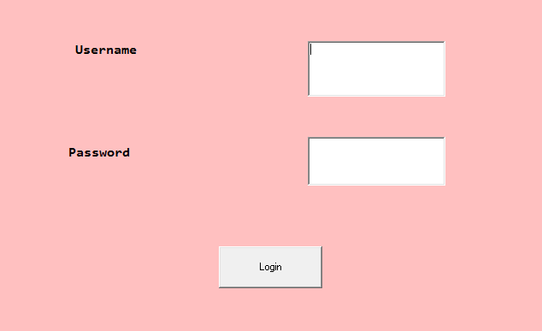

Slide 12
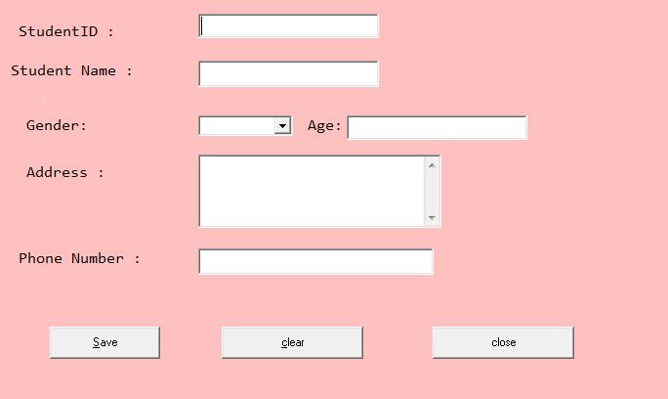

Slide 13
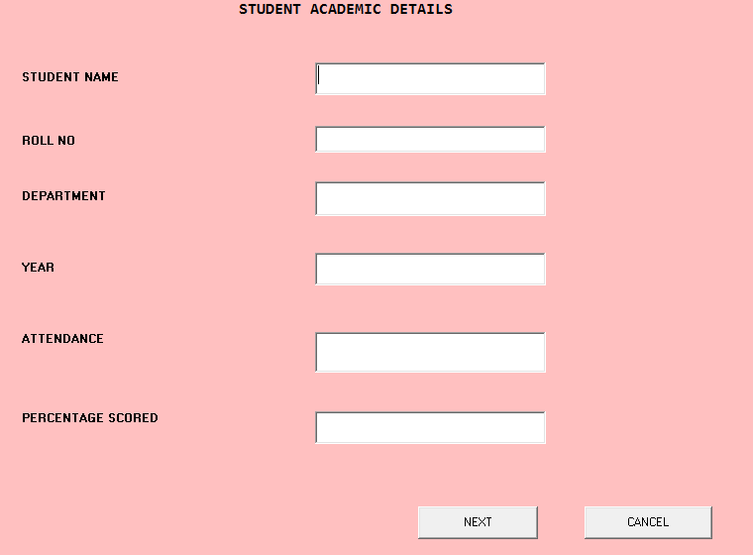

Slide 15
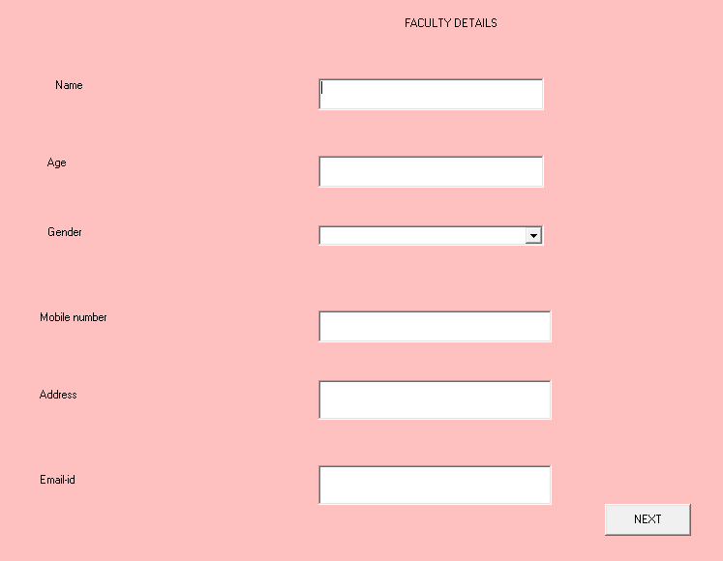

Slide 16
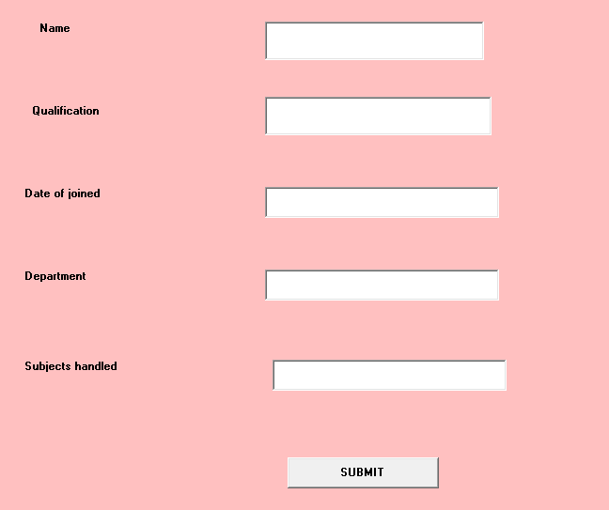

Slide 17
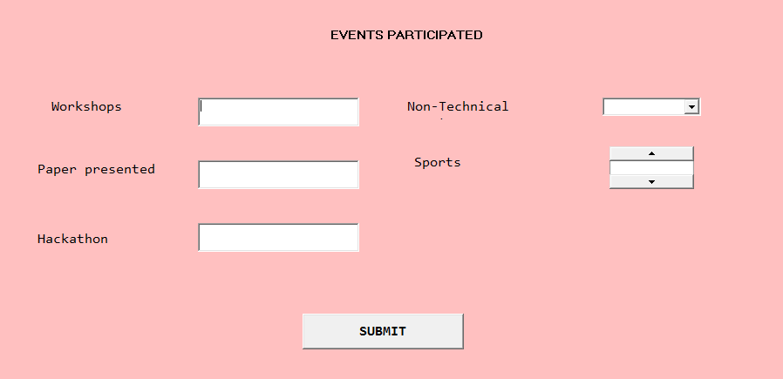

Slide 18
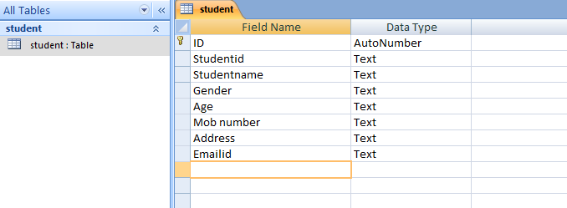

Slide 19
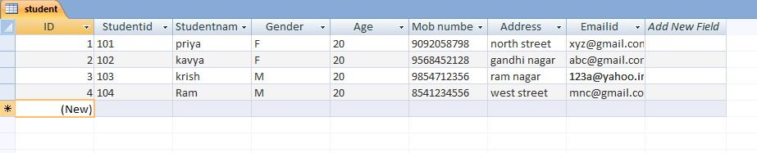

Slide 20
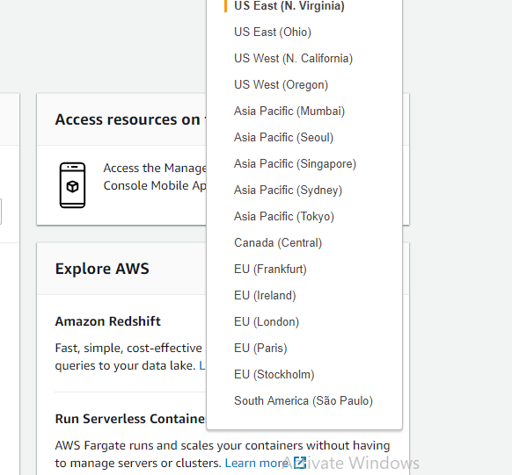

Slide 21
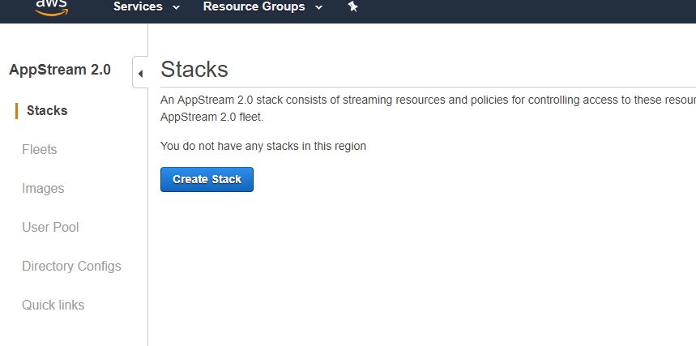

Slide 22
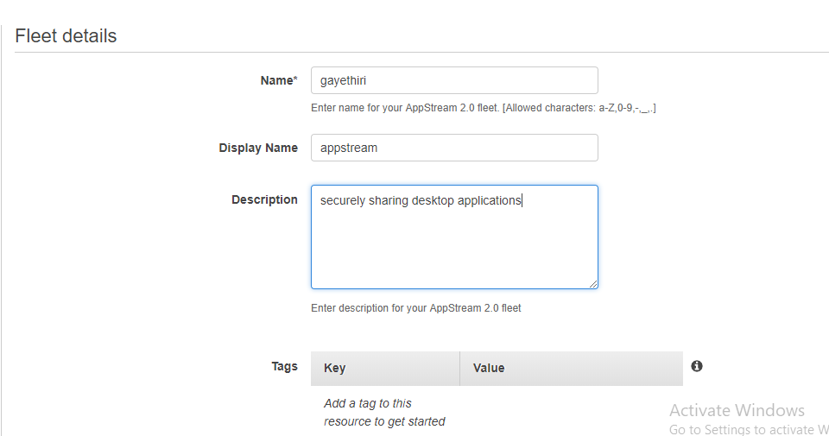

Slide 23
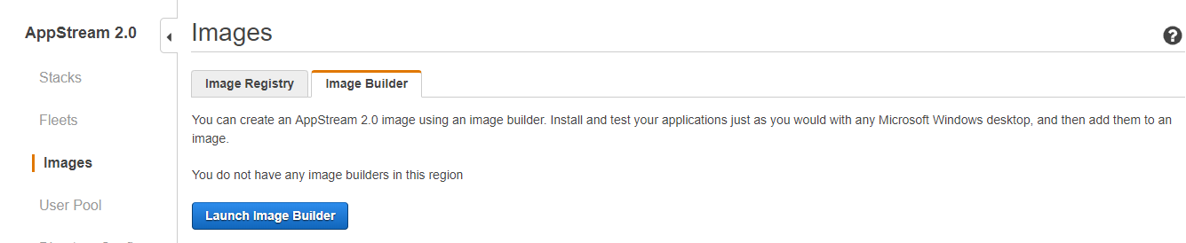

Slide 24
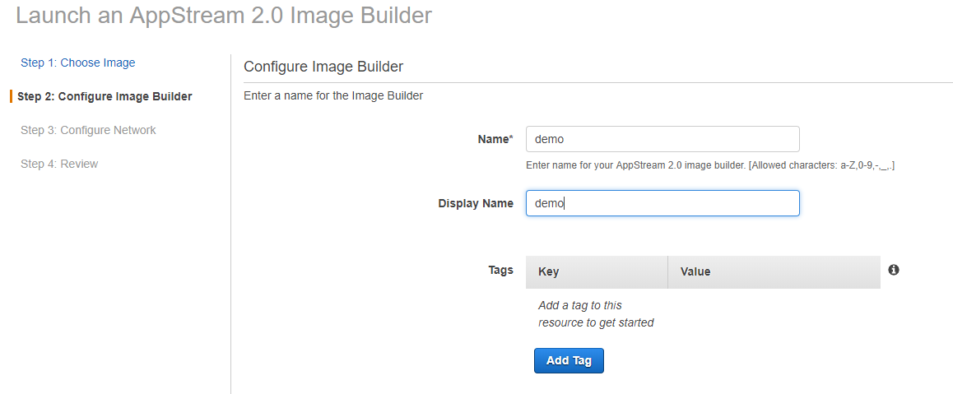

Slide 25
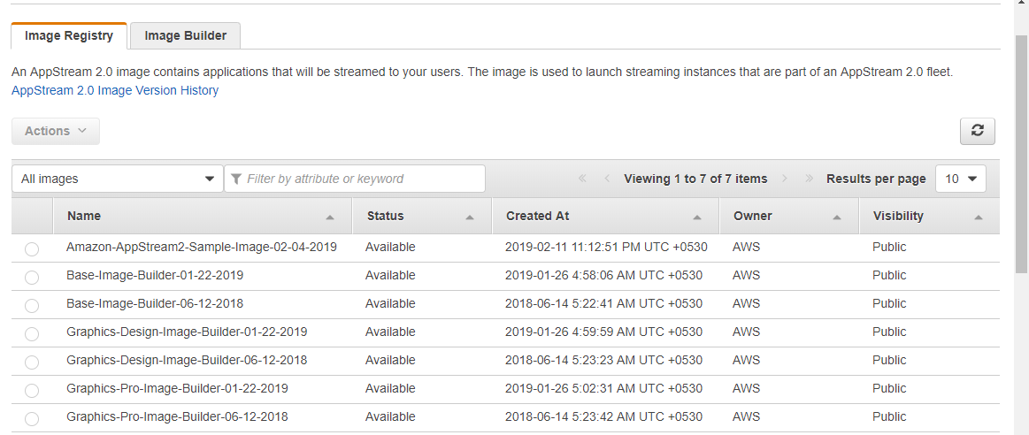

Slide 26
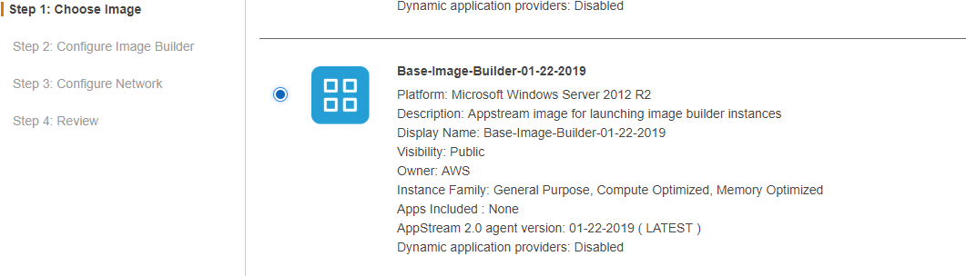

Slide 27
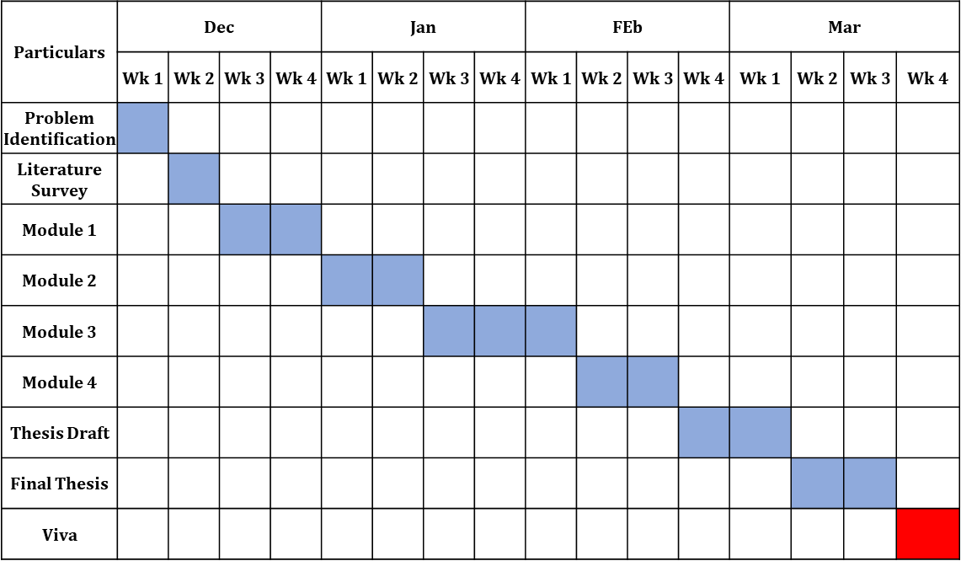
Project Planner / Timeline chart)
Department of CSE, KGiSL Institute of Technology, Coimbatore

Slide 28
THANK YOU

